Slide 1
Wheel of Fortune
Ardley Pacheco, Griffin Ziegler, Abraham Martinez, Jackson Burks, Jerrod Koenigseder
The project pertains to a multi-player word guessing game based on the popular Wheel of Fortune game show, where players take turns spinning a wheel and guessing words from selected categories

Slide 2
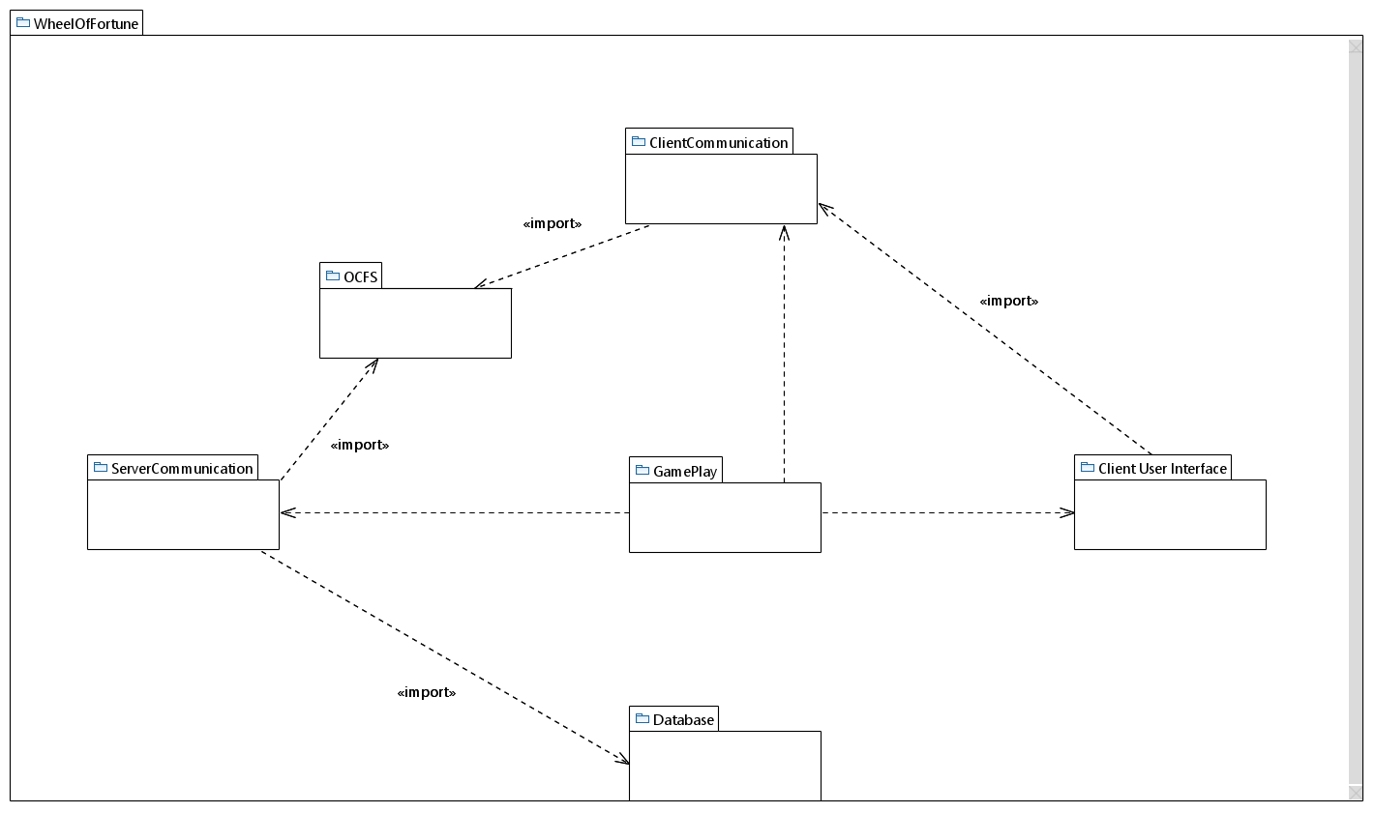
Package Diagram
Griffin
Jackson
Jerrod
Ardley
Abraham
Abraham
Ardley
Griffin

Slide 3
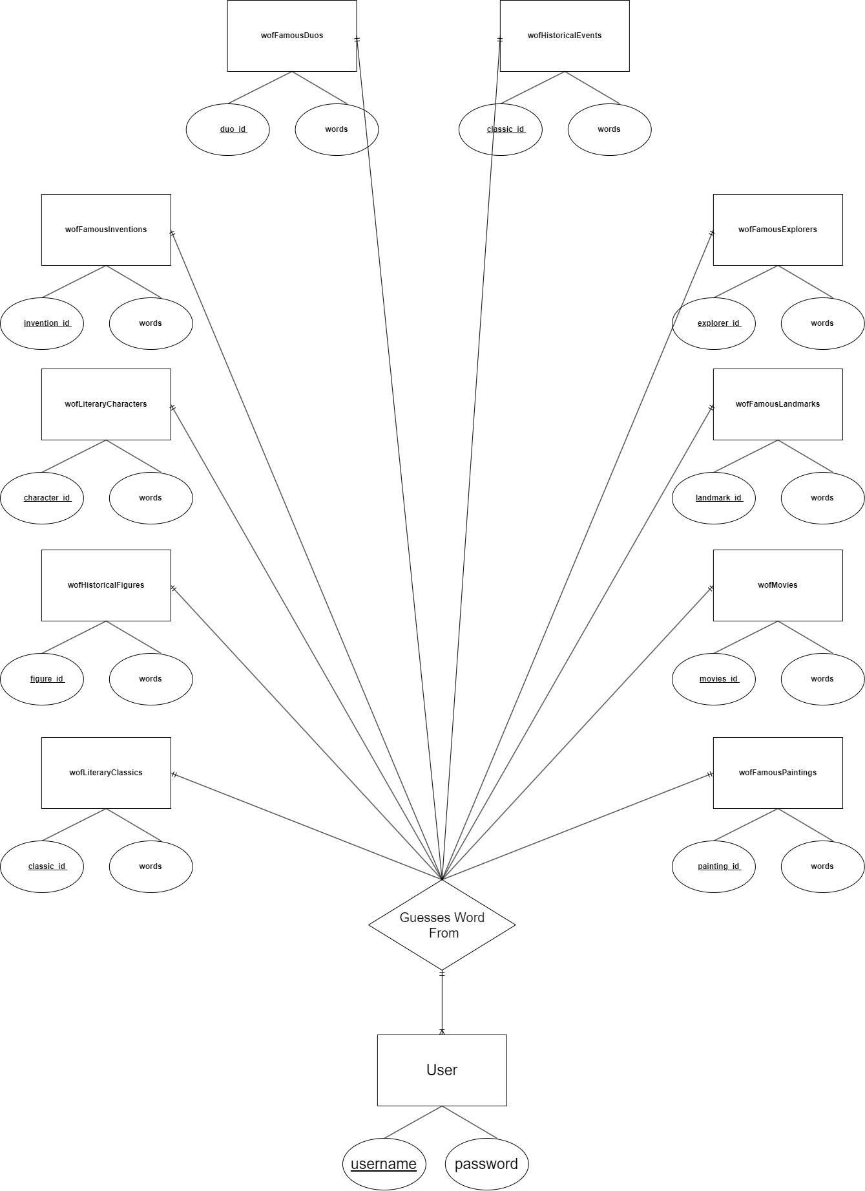
Database Design - ER Diagram

Slide 4
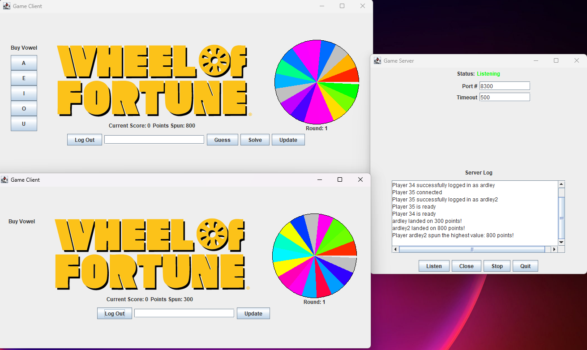
Functional Requirement
When all Players are ready, the game starts, and all Players will spin the wheel. The Player that lands on the highest point value guesses first. (Start Game)

Slide 5
Use-Case Description
Use Case Name: Start Game
Actors: Player
1. System verifies that at least two players have joined the game.
2. Player selects the “Ready” option.
3. System starts a new game with the players once all of them are ready.
4. System displays buttons to “Spin Wheel” and a starting score of zero to all Players.
5. System displays the category and word to guess to all of the players.
Entry Condition:
All Players have joined the game lobby.
Exit Condition:
The System has determined the word for the players to guess.

Slide 6
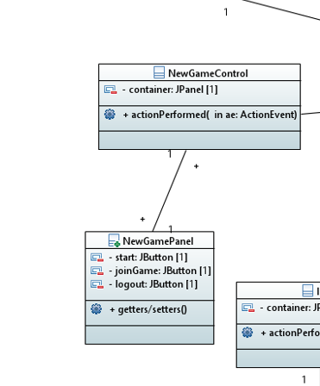
Initial Class Diagram for Use-Case

Slide 7
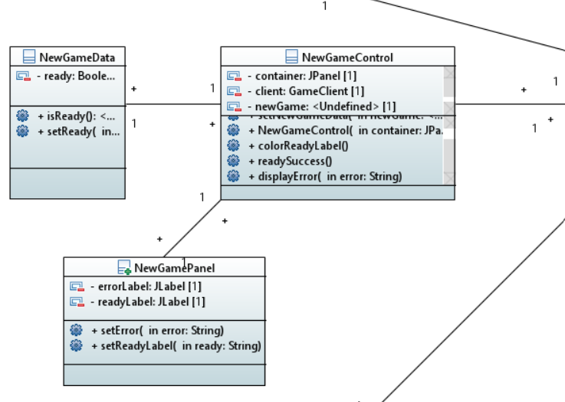
Final Class Diagram for Use-Case

